Slide 1

Artificial Intelligence of Game Design
Andrew Decker
Advisor: Li Feng, Ph.D.

Slide 2

Background of AI
Artificial Intelligence had its conception in the early 1950s
Early AI was modeled off human function
Research began to branch off
Adversarial Search first studied in 1970s
Checkers
Chess
Go

Slide 3
Outline of Presentation
Algorithms → Minimax, Alpha-Beta Pruning, Iterative Deepening
Games → Tic Tac Toe, Connect Four: Rules and Search Spaces
Demonstration
Data
Summary
Future Work
Bibliography

Slide 4
Adversarial Search
A Game is comprised of these things:
Initial State
Player(s)
Action(s)
Result(s, a)
Terminal-Test(s)
Utility(s, p)

Slide 5
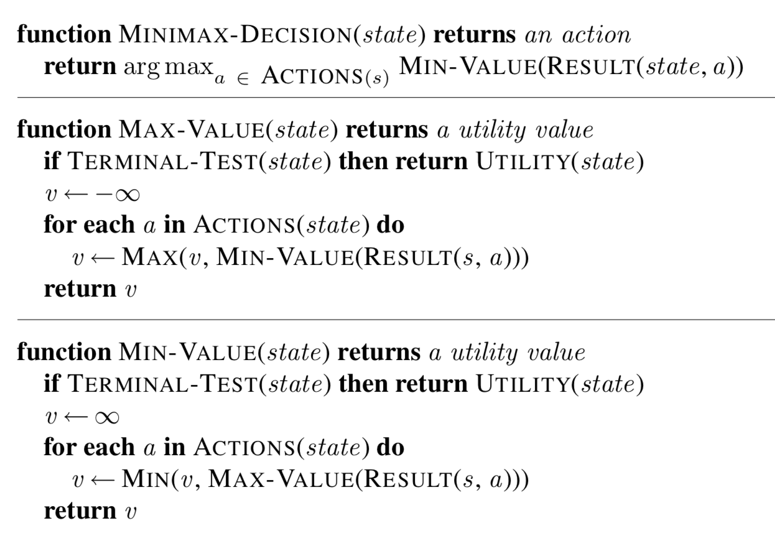
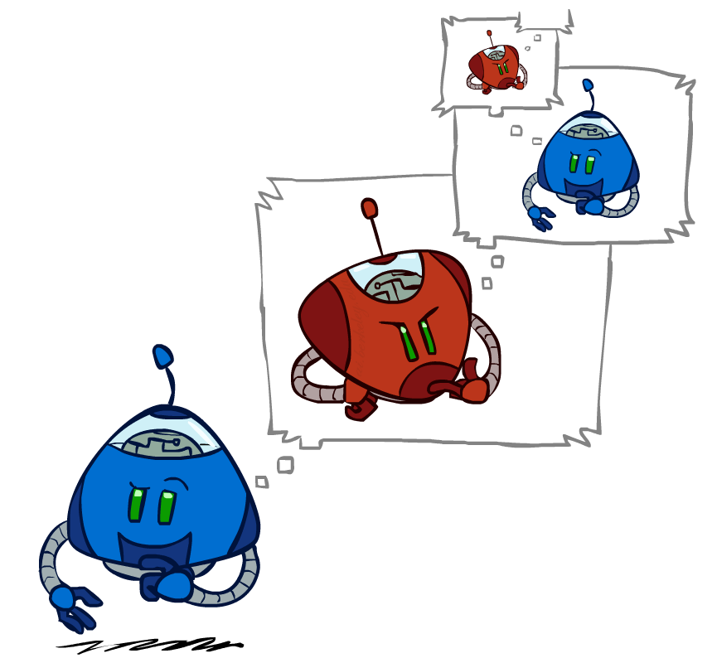
Algorithms
Minimax
A recursive algorithm that computes a specific state’s value for a player

Slide 6
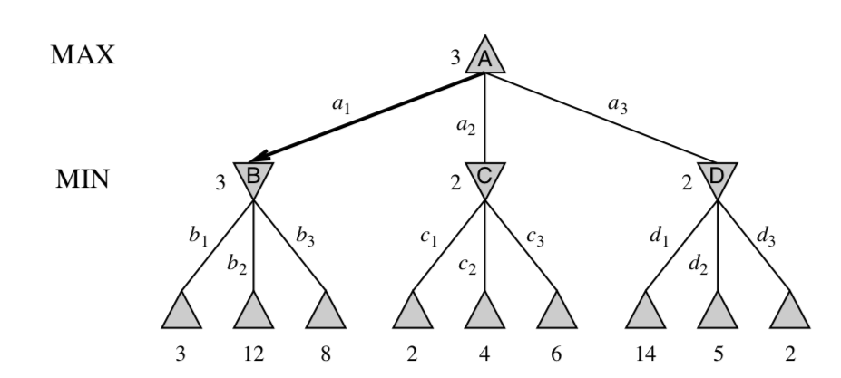
Minimax

Slide 7
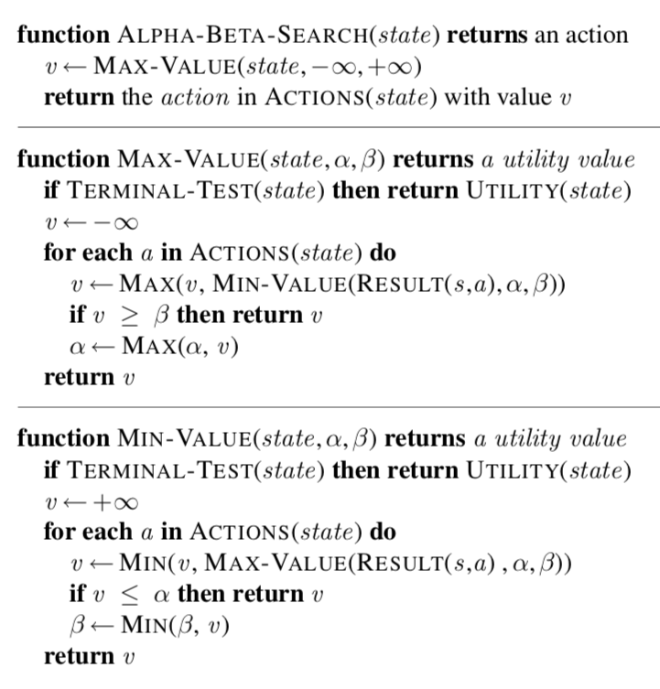
Alpha Beta Pruning
An improvement upon Minimax
Keeps track of an Alpha and Beta value
These values are the best and worse values for each player

Slide 8
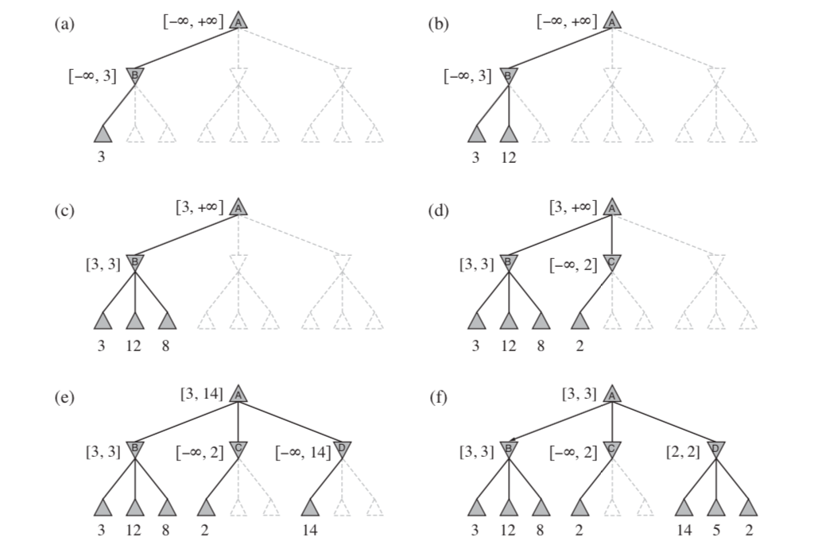
Alpha Beta Pruning

Slide 9
Iterative Deepening
Variation on Alpha-Beta Pruning
Algorithm has time limit on search
Searches at depth 1, then 2, then 3… until time expires
Some time wasted by searching through same shallow depths

Slide 10
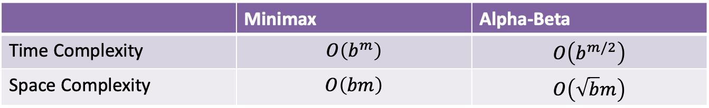
Algorithm Comparison
 | Minimax | Alpha-Beta
Time Complexity | $$O\left(b^{m}\right)$$ | $$O\left(b^{m/2}\right)$$
Space Complexity | $$O\left(bm\right)$$ | $$O\left(\sqrt{b}m\right)$$
b: branching factor
m: maximum depth

Slide 11
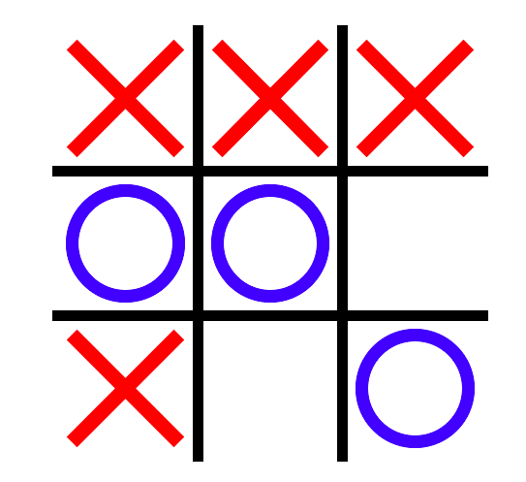
Tic Tac Toe
Two person, turning taking game
3 x 3 gird
To win: 3 like pieces in a row, column, diagonal
Search Space: 9! = 362,880

Slide 12
Connect Four
Two person, turning taking game
7 x 6 Grid
To win: 4 like pieces in a row, column, or diagonal
Legal moves: on lowest row, or on top of other pieces
Search Space: 4,531,985,219,092

Slide 13
Demonstration

Slide 14
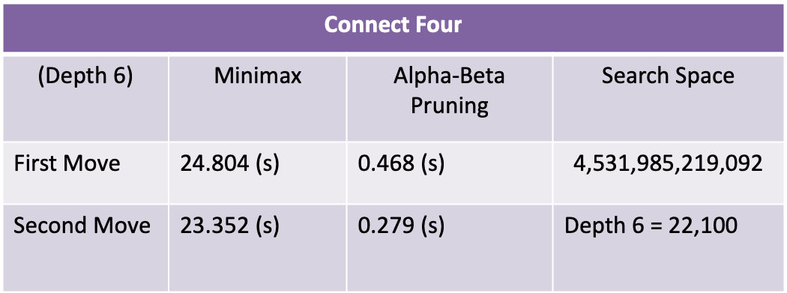
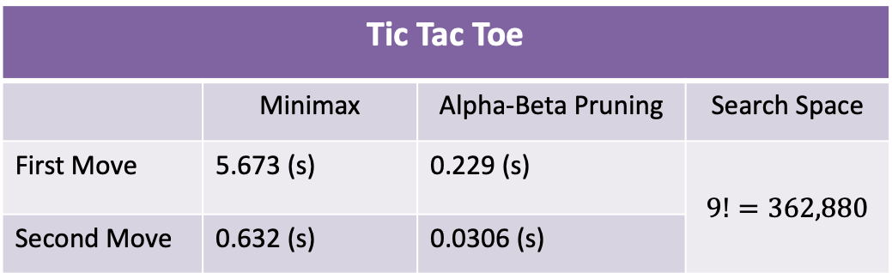
Data
Tic Tac Toe
 | Minimax | Alpha-Beta Pruning | Search Space
First Move | 5.673 (s) | 0.229 (s) | $$9!=362,880$$
Second Move | 0.632 (s) | 0.0306 (s)
Connect Four
(Depth 6) | Minimax | Alpha-Beta Pruning | Search Space
First Move | 24.804 (s) | 0.468 (s) | $$\text{4,531,985,219,092}$$
Second Move | 23.352 (s) | 0.279 (s) | Depth 6 = 22,100

Slide 15
Data

Slide 16

Data
Minimax: $0.002e^{1.9124x} →$ $e^{1.9124x}$
Time Complexity: $O(b^{m})$
Alpha Beta: $0.003e^{1.1302x} →$ $e^{1.1302x}$
Time Complexity: $O(b^{m/2})$
$$\frac{1.13}{1.91}=0.59$$

Slide 17
Summary
Minimax and Alpha-Beta Pruning are both optimal Algorithms
Alpha-Beta Pruning is more efficient than Minimax
Streamlining the evaluation function would optimize Alpha-Beta pruning

Slide 18
Future Work
Continue work on Connect Four
Add different game modes and home screen
Optimize algorithms more: Ex. better move ordering
Anticipate and block losing moves

Slide 19
Bibliography
Pons, P. (2016, May 01). Part 1 – Introduction. Retrieved July 24, 2018, from http://blog.gamesolver.org/solving-connect-four/01-introduction/
Russell, S. J., & Norvig, P. (2010). Artificial intelligence: A modern approach(Third ed.). Upper Saddle River, NJ: Prentice Hall.
Tromp, J. (2012, May 23). A212693 - OEIS. Retrieved July 24, 2018, from https://oeis.org/A212693
Zelle, J. M. (2017). Python Programming: An Introduction To Computer Science, Third Edition. Franklin, Beedle & Associates.

